Slide 1

Notes:
MODULE 7: REVENUE DIVERSIFICATION

Slide 2
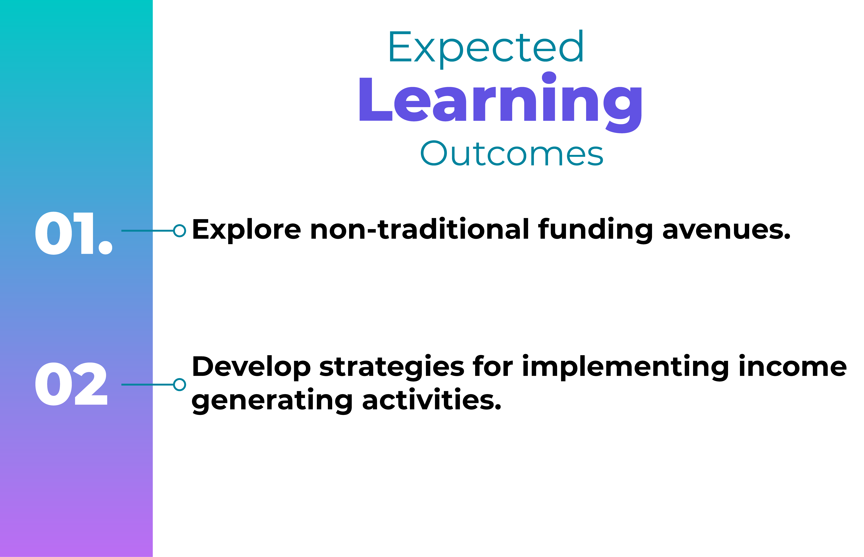
Module Objectives and Learning Outcomes
Module Objective: This module focuses on equipping you with practical strategies to explore and implement non-traditional funding models, ensuring financial sustainability for your social enterprise.
Notes:
Module Objectives and Learning Outcomes.
Module Objective: This module focuses on equipping you with practical strategies to explore and implement non-traditional funding models, ensuring financial sustainability for your social enterprise.
Learning Outcomes
Explore non-traditional funding avenues.
Develop strategies for implementing income generating activities.

Slide 3
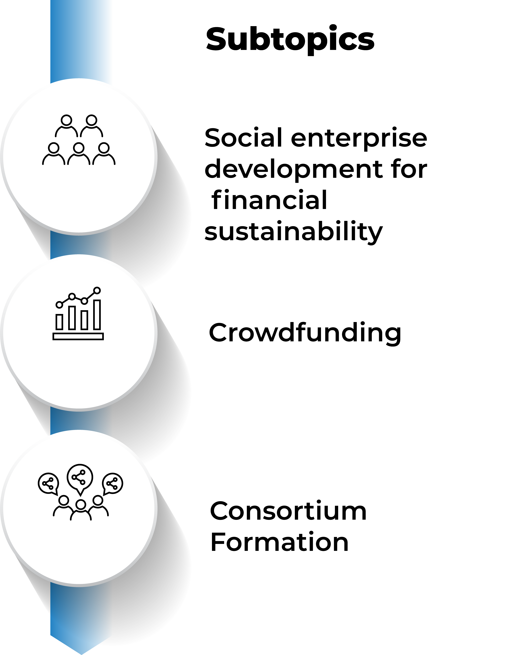
Notes:
Subtopics.
Social enterprise development for financial sustainability.
Crowdfunding.
3. Consortium Formation.

Slide 4
Social Enterprise development for financial sustainability
Social enterprises (SEs) are entities that create social value while maintaining financial sustainability through a business model.
Notes:
Social Enterprise is the future of business—a future where doing good and doing well go hand in hand. Social Enterprise is where business and social impact come together to create innovative solutions for real-world problems.
At the heart of a social enterprise is a simple, powerful idea: to harness the power of business to drive social change. These enterprises use market-driven strategies to achieve social, environmental, or cultural outcomes, all while remaining financially sustainable. Social impact plus business—that’s the magic formula for creating lasting change.

Slide 5
Social Enterprise development for financial sustainability
Social enterprises (SEs) are entities that create social value while maintaining financial sustainability through a business model.
Notes:
But what makes a social enterprise different? Innovative businesses with social impact aren’t just focused on profits; they are driven by a mission to make the world a better place. These businesses take on issues like poverty, education, healthcare, environmental sustainability, and so much more, using fresh, creative approaches that disrupt traditional industries.
From clean energy startups to fair-trade companies, from microfinance organizations to social enterprises in education and healthcare—the potential is limitless. These businesses don’t just sell products or services; they catalyze social transformation by addressing critical challenges, improving lives, and empowering communities.

Slide 6
Social Enterprise development for financial sustainability
Social enterprises (SEs) are entities that create social value while maintaining financial sustainability through a business model.
Notes:
Through social enterprise, businesses can create a ripple effect, inspiring others, influencing policies, and bringing innovative solutions to the forefront of social progress. These enterprises prove that you can do well and do good. By blending purpose and profit, they show us how business can be a force for positive change. So, whether you're starting your own social enterprise or supporting others, remember: it's all about making a positive impact while ensuring that your business is sustainable, scalable, and focused on long-term transformation.

Slide 7
Social Enterprise development
1. Identify the social issues
Identify the Social Issues
Research and understand the specific social problem
Align it with the NGOs values and mission
Notes:
Let’s dive into the essential steps of building a strong foundation for your social enterprise.
First, begin by identifying the social issues you aim to tackle. This is the starting point for everything. You need to research and understand the specific social problem you want to address. This deep understanding will help ensure that your efforts are both relevant and impactful. Ensure you align the proposed social issue with the values and mission of your organization. Make sure that the social issue you’re addressing fits seamlessly with your overall goals. Your mission is your compass—it defines your purpose and guides every decision you make.

Slide 8
Social Enterprise development
2. Define your mission and vision
Define your mission and vision
Articulate the mission and vision
Notes:
Once you've identified the issue and aligned it with your mission, it’s time to define your mission and vision more clearly. Your mission is what you do—it’s the core of your work. Your vision is the future you want to create. Together, they form the backbone of the social enterprise strategy. Take time to articulate both your mission and vision in a way that is clear, inspiring, and easy for others to understand. This will keep you focused and guide your efforts moving forward.

Slide 9
Social Enterprise development
3. Right Legal Structure
Right Legal Structure
Options, non-profit, for profit or hybrid
Consider- Country legal and regulatory framework, Taxation
Notes:
Now, let’s talk about the legal structure for your organization. One of the key decisions you’ll need to make is whether you will operate as a non-profit, a for-profit, or a hybrid organization. Each option comes with its own set of benefits and challenges, so it’s important to carefully consider the legal and regulatory framework of the country where you operate. Your decision will impact your funding sources, operations, and even how you engage with your stakeholders.

Slide 10
Social Enterprise development
4. Business Model
Business Model
Think Business Model- Fee for Service, product sales etc
Notes:
Once your structure is in place, it’s time to develop your business model. Think about how your organization will generate revenue and sustain itself. Will you use a fee-for-service model, offering services in exchange for payment? Or will you focus on product sales, such as selling goods or services that support your mission? You can also consider other models, like donations, crowdfunding, or social impact investments. Your business model should align with both your mission and your financial goals.

Slide 11
Social Enterprise development
5. Strategic Plan
Strategic Plan
Lay out the roadmap- Short, Medium and long term
Notes:
Finally, you need a strategic plan to guide your enterprise growth and impact. Lay out a clear roadmap for your work, considering short-term, medium-term, and long-term goals. What do you want to achieve in the next year? The next three years? And where do you see your enterprise in five or ten years? A solid strategic plan will ensure that you're not only creating impact today but also setting up for sustainable growth in the future.

Slide 12
Steps- Social Enterprise development
Identify the Social Issues
Research and understand the specific social problem
Align it with the NGOs values and mission
Define your mission and vision
Articulate the mission and vision
Right Legal Structure
Options, non-profit, for profit or hybrid
Consider- Country legal and regulatory framework, Taxation
Business Model
Think Business Model- Fee for Service, product sales etc
Strategic Plan
Lay out the roadmap- Short, Medium and long term
Notes:
This Diagram is a representation of all the steps in the process.

Slide 13
Building a Strong Business Model Canvas
Business Model Canvas
Key Partners | Key Activities | Value Propositions |  |  | Customer Relationships |  | Customer Segments
Who will you partner with? Supplier, government etc. | What are the key activities that will keep the social enterprise running? E.g., product development, service delivery | what makes your enterprise unique? |  |  | How are you creating lasting, impactful connections with your customers? |  | Who are you serving?
 | Key Resources |  |  |  | Channels
 | What are the assets and resources needed? |  |  |  | How will you deliver your value proposition to your customers? –Online, In-person etc
Cost Structure |  |  | Revenue Streams
What are the key costs to run the enterprise? |  |  | How will your social enterprise make money? i.e. product sales, fee for service, subscription fees etc.
Notes:
Let’s dive into one of the most important tools for developing a social enterprise—the Business Canvas. This simple, yet powerful framework helps you map out your social enterprise’s key elements on a single page, giving you a clear overview of how your business will operate and create value. The Business Canvas has nine essential components that we’ll go through one by one, each representing a critical part of your business strategy.
First, we have Customer Segments. Who are you serving? In a social enterprise, these are typically communities or groups facing a specific social challenge. You need to clearly identify your target audience, whether they’re individuals in need, businesses, or organizations. Understand their needs, pain points, and how your enterprise can address them.
Next is the Value Proposition. This is the heart of your social enterprise—what makes your enterprise unique? How are you solving the problem in a way that no one else does? Whether it’s offering a product, a service, or an experience, your value proposition clearly articulates how you’re meeting the needs of your customer segments and driving social impact.
Moving on to Channels. How will you deliver your value proposition to your customers? These could be physical or digital channels like online platforms, in-person events, or partnerships with other organizations. It's important to think about how you’ll reach your target audience effectively.
Now, let’s talk about Customer Relationships. Building strong relationships with your customers is key, especially in a social enterprise where trust and engagement are central to success. Will you have a community-building approach? Will your customers be involved in your mission beyond just purchasing your product or service? This is where you outline how you’ll create lasting, impactful connections with your audience.
Next, we have Revenue Streams. How will your social enterprise make money? This could be through a variety of ways: product sales, subscriptions, service fees, or even donations. It’s important to think about how you’ll create sustainable revenue while staying true to your social mission.
Then, we get to Key Resources. These are the assets and resources you need to run your social enterprise. Think about everything you’ll need to deliver your value proposition: human resources, technology, physical infrastructure, financial capital, and more. The goal is to identify what’s absolutely necessary to operate effectively.
After that, we have Key Activities. What are the most important actions or processes you’ll need to carry out to deliver on your mission? Whether it’s product development, community outreach, fundraising, or service delivery, this is where you lay out the activities that will keep your enterprise running smoothly.
Next is Key Partnerships. No social enterprise operates alone. Think about who you’ll partner with—whether it’s other organizations, governments, suppliers, or funders. Partnerships can provide critical resources, support, and expand your reach, helping you scale your impact.
Finally, we have Cost Structure. This is where you outline the key costs involved in running your business. These could include operational costs, salaries, marketing, production, and any other costs necessary to sustain your enterprise. Balancing costs with revenue is key to ensuring your long-term financial sustainability.

Slide 14
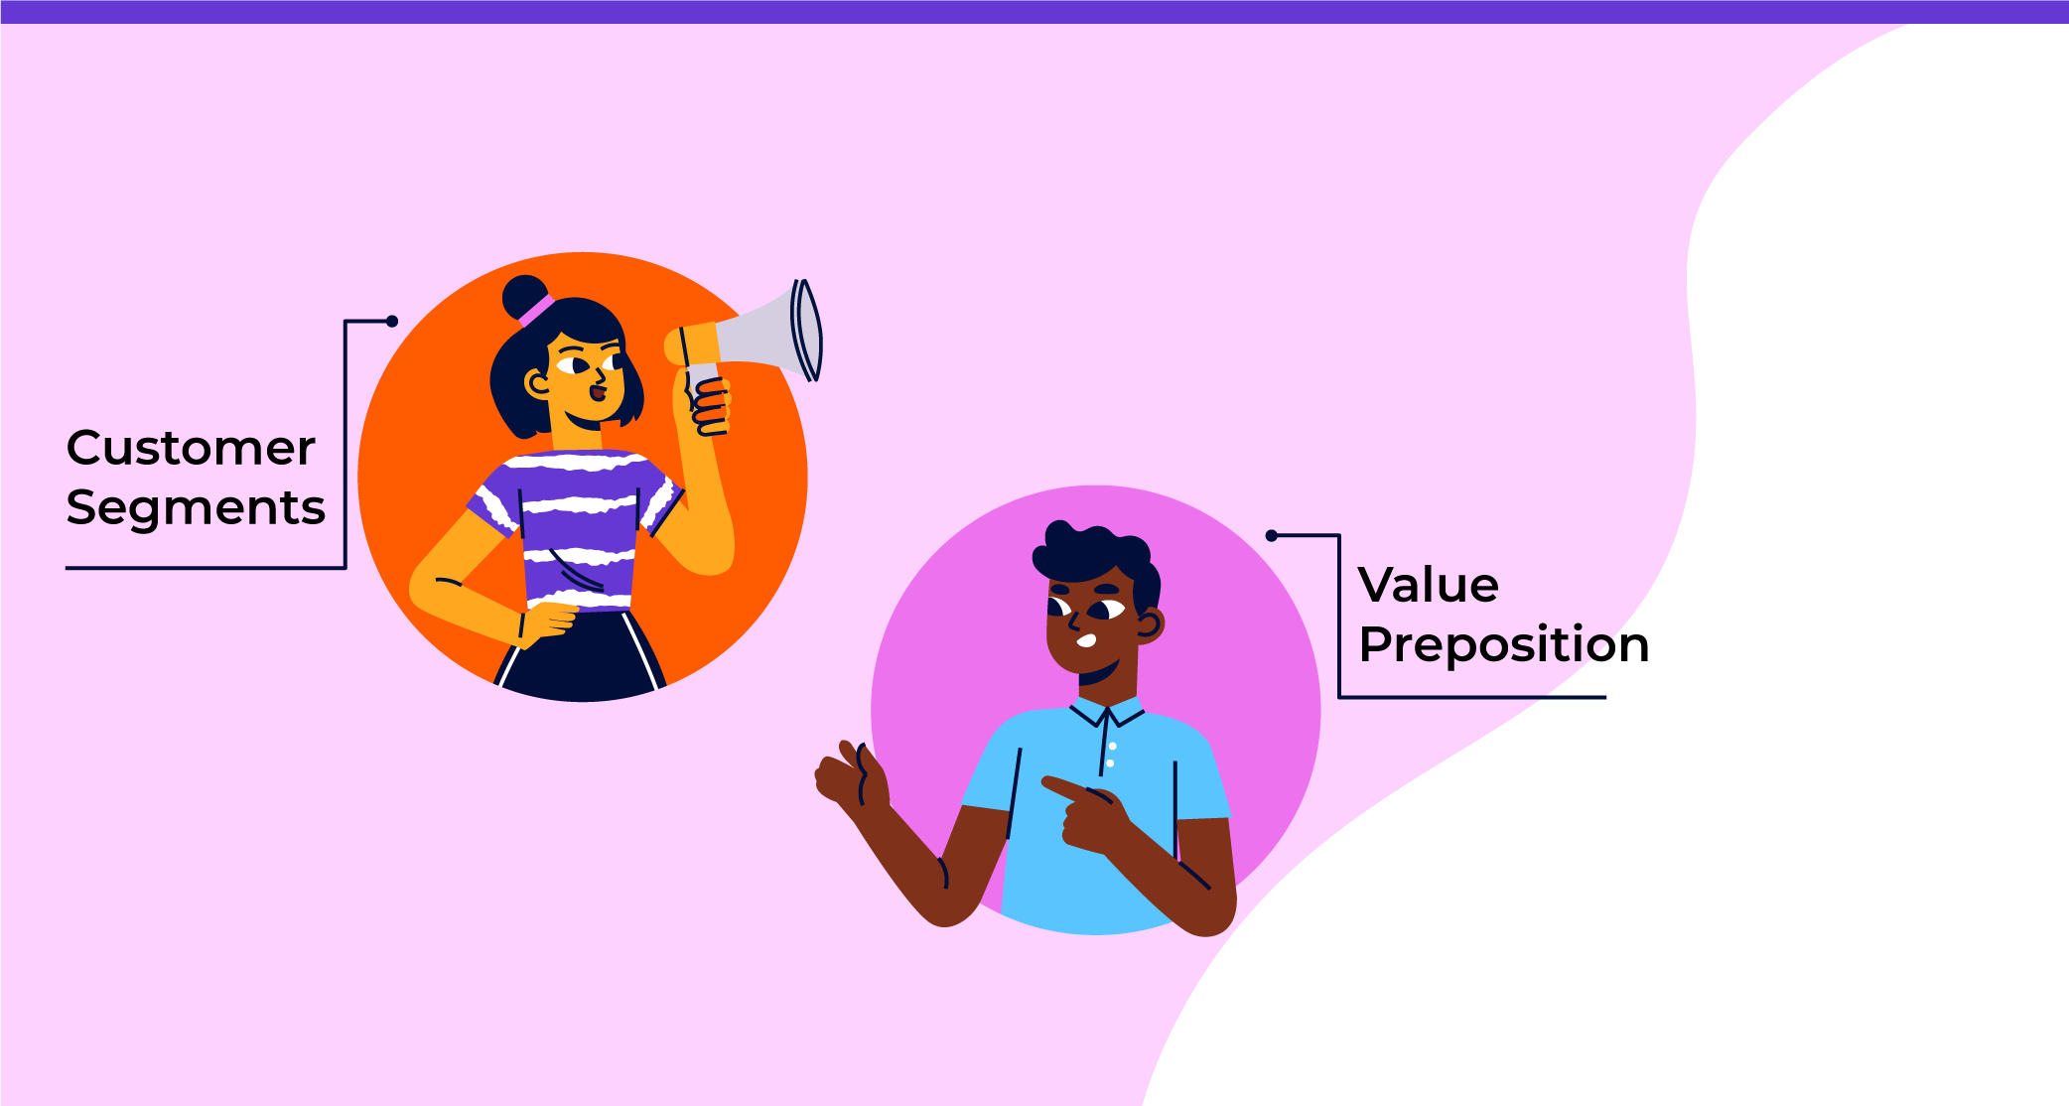
First, we have Customer Segments. Who are you serving? In a social enterprise, these are typically communities or groups facing a specific social challenge. You need to clearly identify your target audience, whether they’re individuals in need, businesses, or organizations. Understand their needs, pain points, and how your enterprise can address them.
Next is the Value Proposition. This is the heart of your social enterprise—what makes your enterprise unique? How are you solving the problem in a way that no one else does? Whether it’s offering a product, a service, or an experience, your value proposition clearly articulates how you’re meeting the needs of your customer segments and driving social impact.
Notes:
First, we have Customer Segments. Who are you serving? In a social enterprise, these are typically communities or groups facing a specific social challenge. You need to clearly identify your target audience, whether they’re individuals in need, businesses, or organizations. Understand their needs, pain points, and how your enterprise can address them.
Next is the Value Proposition. This is the heart of your social enterprise—what makes your enterprise unique? How are you solving the problem in a way that no one else does? Whether it’s offering a product, a service, or an experience, your value proposition clearly articulates how you’re meeting the needs of your customer segments and driving social impact.

Slide 15
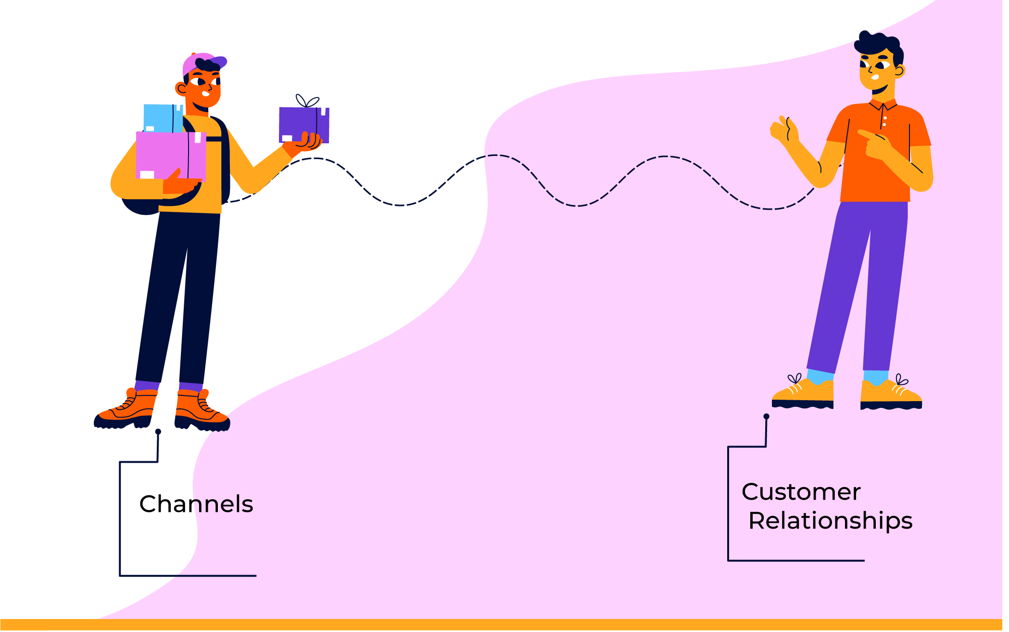
Moving on to Channels. How will you deliver your value proposition to your customers? These could be physical or digital channels like online platforms, in-person events, or partnerships with other organizations. It's important to think about how you’ll reach your target audience effectively.
Now, let’s talk about Customer Relationships. Building strong relationships with your customers is key, especially in a social enterprise where trust and engagement are central to success. Will you have a community-building approach? Will your customers be involved in your mission beyond just purchasing your product or service? This is where you outline how you’ll create lasting, impactful connections with your audience.
Notes:
Moving on to Channels. How will you deliver your value proposition to your customers? These could be physical or digital channels like online platforms, in-person events, or partnerships with other organizations. It's important to think about how you’ll reach your target audience effectively.
Now, let’s talk about Customer Relationships. Building strong relationships with your customers is key, especially in a social enterprise where trust and engagement are central to success. Will you have a community-building approach? Will your customers be involved in your mission beyond just purchasing your product or service? This is where you outline how you’ll create lasting, impactful connections with your audience.

Slide 16
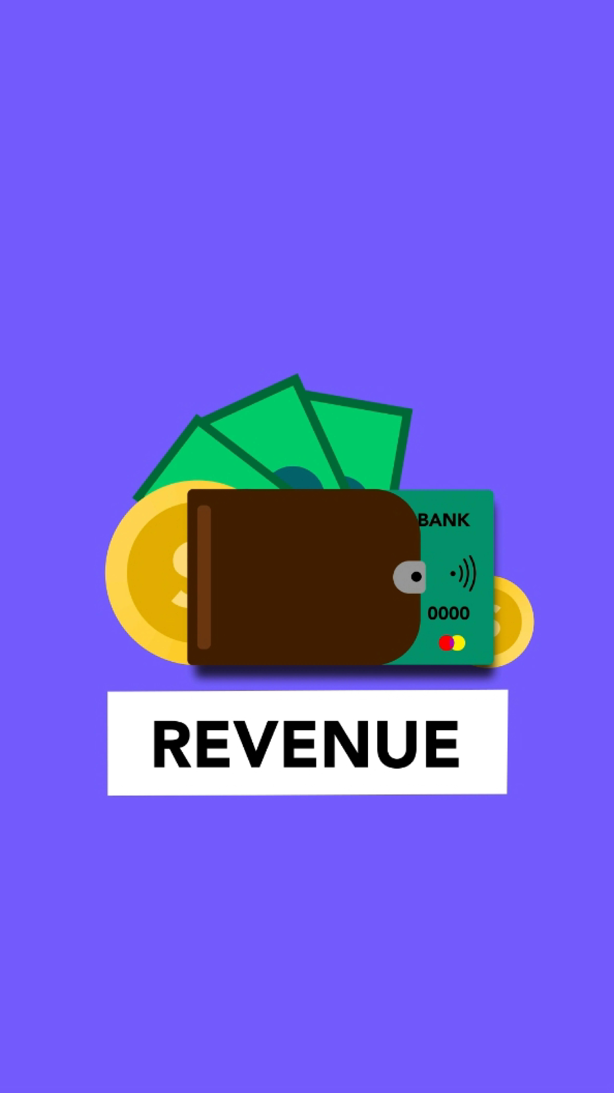
Next, we have Revenue Streams. How will your social enterprise make money? This could be through a variety of ways: product sales, subscriptions, service fees, or even donations. It’s important to think about how you’ll create sustainable revenue while staying true to your social mission.
Then, we get to Key Resources. These are the assets and resources you need to run your social enterprise. Think about everything you’ll need to deliver your value proposition: human resources, technology, physical infrastructure, financial capital, and more. The goal is to identify what’s absolutely necessary to operate effectively.
Notes:
Next, we have Revenue Streams. How will your social enterprise make money? This could be through a variety of ways: product sales, subscriptions, service fees, or even donations. It’s important to think about how you’ll create sustainable revenue while staying true to your social mission.
Then, we get to Key Resources. These are the assets and resources you need to run your social enterprise. Think about everything you’ll need to deliver your value proposition: human resources, technology, physical infrastructure, financial capital, and more. The goal is to identify what’s absolutely necessary to operate effectively.

Slide 17
After that, we have Key Activities. What are the most important actions or processes you’ll need to carry out to deliver on your mission? Whether it’s product development, community outreach, fundraising, or service delivery, this is where you lay out the activities that will keep your enterprise running smoothly.
Next is Key Partnerships. No social enterprise operates alone. Think about who you’ll partner with—whether it’s other organizations, governments, suppliers, or funders. Partnerships can provide critical resources, support, and expand your reach, helping you scale your impact.
Finally, we have Cost Structure. This is where you outline the key costs involved in running your business. These could include operational costs, salaries, marketing, production, and any other costs necessary to sustain your enterprise. Balancing costs with revenue is key to ensuring your long-term financial sustainability.
Notes:
After that, we have Key Activities. What are the most important actions or processes you’ll need to carry out to deliver on your mission? Whether it’s product development, community outreach, fundraising, or service delivery, this is where you lay out the activities that will keep your enterprise running smoothly.
Next is Key Partnerships. No social enterprise operates alone. Think about who you’ll partner with—whether it’s other organizations, governments, suppliers, or funders. Partnerships can provide critical resources, support, and expand your reach, helping you scale your impact.
Finally, we have Cost Structure. This is where you outline the key costs involved in running your business. These could include operational costs, salaries, marketing, production, and any other costs necessary to sustain your enterprise. Balancing costs with revenue is key to ensuring your long-term financial sustainability.

Slide 18
The Social Enterprise Business Plan
The Business Plan outlines the strategy, objectives, and operational approach for the Social Enterprise
1. Market Analysis
Who are your customers, and what are their needs?
2. Business Model Canvas
How will the business create and deliver value?
3. Financial Model
How will you generate income?
4. Financial Forecast
What are the financial projections and assumptions?
5. Break-even Analysis
When will you start making profits?
6. Marketing Strategies
How will you attract and retain customers or donors?
7. Impact Measurement
How will you attract and retain customers or donors?
Notes:
Creating a solid business plan is one of the most important steps in launching a successful social enterprise. A well-structured business plan will serve as your roadmap, guiding you through the journey of turning your mission into a sustainable, impactful business.
So, let’s break it down step by step.

Slide 19
1. MARKET ANALYSIS
Define your Market Analysis. Who are your customers, and what are their needs? How big is the market for your solution?
Here, you'll need to research and present data about your target audience, your competitors, and any trends that might influence your enterprise. This is where you prove that there's a real demand for your product or service, and that you’ve thought carefully about the landscape you’re entering.
Notes:
Define your Market Analysis. Who are your customers, and what are their needs? How big is the market for your solution? Here, you'll need to research and present data about your target audience, your competitors, and any trends that might influence your enterprise. This is where you prove that there's a real demand for your product or service, and that you’ve thought carefully about the landscape you’re entering.

Slide 20
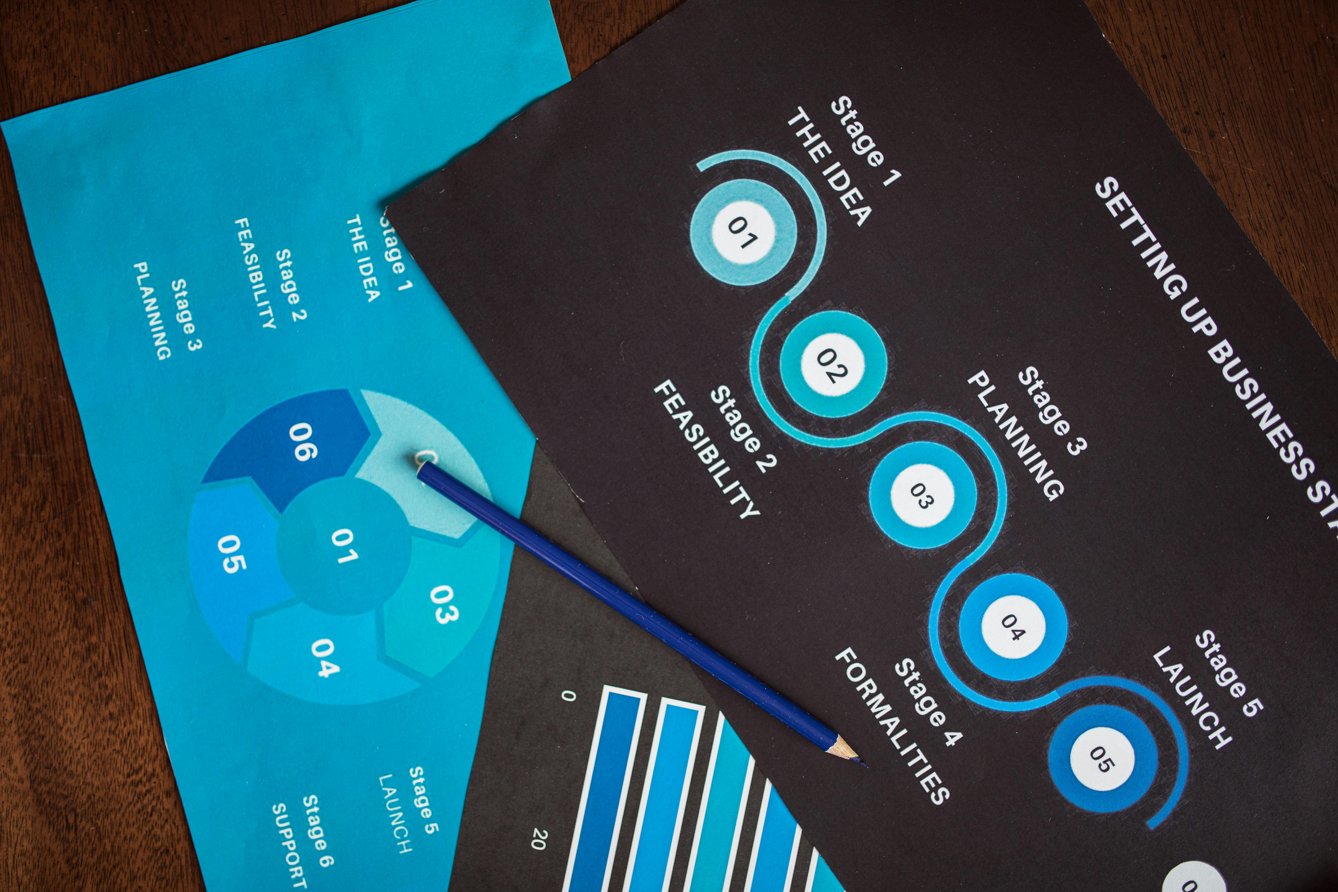
2. BUSINESS MODEL
Next comes the Business Model. Make reference to the business model canvas already developed. This is where you explain how your social enterprise will create and deliver value. Will you generate revenue through product sales? Service fees? Donations or grants? Or perhaps a subscription model? You’ll need to lay out how your business will operate and make money, while staying true to your mission. This section shows that you have a sustainable path forward.
Notes:
Define your Market Analysis. Who are your customers, and what are their needs? How big is the market for your solution? Here, you'll need to research and present data about your target audience, your competitors, and any trends that might influence your enterprise. This is where you prove that there's a real demand for your product or service, and that you’ve thought carefully about the landscape you’re entering.

Slide 21

3. THE FINANCIAL MODEL
And this leads us to one of the most important parts of your business plan: the Financial Model. Your financial model shows exactly how your social enterprise plans to make money and stay financially viable over time. You need to be clear about your revenue streams—this is how you’ll bring in money to sustain your operations and grow your impact. Will you charge for your products or services, or will you rely on grants? The more diversified your revenue streams, the more resilient your enterprise will be. You also need to show your cost structure. What are the key costs involved in running your business? This includes everything from production and labor costs to marketing and operational expenses. A well-planned financial model ensures that your revenue can cover these costs, while also allowing for growth.
Notes:
Define your Market Analysis. Who are your customers, and what are their needs? How big is the market for your solution? Here, you'll need to research and present data about your target audience, your competitors, and any trends that might influence your enterprise. This is where you prove that there's a real demand for your product or service, and that you’ve thought carefully about the landscape you’re entering.

Slide 22
Social Enterprise- Measuring Impact and Reporting
Impact measurement will involve assessing the social, environmental, or economic effects of the social enterprise’s activities.
SROI= Net Present Value of Social Value Created​
Investment or Inputs
Let's say a social enterprise invested $100,000 in a community health program. Over the next 5 years, the program generated $500,000 in social value (improved health outcomes, cost savings in healthcare, etc.).
The SROI would be calculated as:
SROI= 500,000/100,000
This means that for every $1 invested, $5 of social value is created.
Notes:
Let’s break down how to calculate Social Return on Investment, and why it’s so powerful for understanding the impact of a social enterprise.
The formula for SROI is simple:
Social Return on Investment = Net Present Value of Social Value Created divided by Investment or Inputs.
In other words, you’re comparing the value your project creates—social, environmental, or economic—with the amount you’ve invested in it. It's about understanding how much social impact you’re generating for every dollar spent.
Imagine a social enterprise invests $100,000 in a community health program. Over the next five years, this program creates $500,000 in social value—this could be things like improved health outcomes, reduced healthcare costs, or other community benefits.
So, let’s apply this to our SROI formula:
Social Return on Investment = $500,000 divided by $100,000
Now, when you do the math, it gives us an SROI of 5.
What does this mean? It means that for every dollar the social enterprise invested, $5 worth of social value was created. That’s a 5-to-1 ratio—for every dollar spent, the program generated five times that in value.
This is a clear, powerful way of showing the impact your initiative is having. Not just in terms of finances, but in real, tangible benefits that improve lives and communities.

Slide 23
Social Enterprise- Sustainability
Diversify Your Revenue Stream
Measure and Communicate Impact
Partnerships and Networks
Scalable and Replicable Model
Financial Discipline and Planning
Having a diversified income portfolio. Mix of earned income, social impact investment etc
Demonstrate real and tangible impact,
Build strong partnerships and Networks
Focus on a business model that is scalable—that is, one that can grow and replicated in different regions
Create a solid financial plan, with clear projections and reserves,
Notes:
Let’s talk about the sustainability of social enterprises. It’s not just about creating positive social impact—it’s also about ensuring your business is financially viable in the long term. Here are five key pointers that can help you ensure the sustainability of your social enterprise:

Slide 24
Notes:
1. Diversify Your Revenue Streams:
One of the best ways to make sure your social enterprise stays sustainable is by not relying on just one source of income. Whether it's through a mix of grants, earned income, or social impact investments—having a diversified income portfolio means you're not as vulnerable to the ups and downs of a single funding stream.

Slide 25
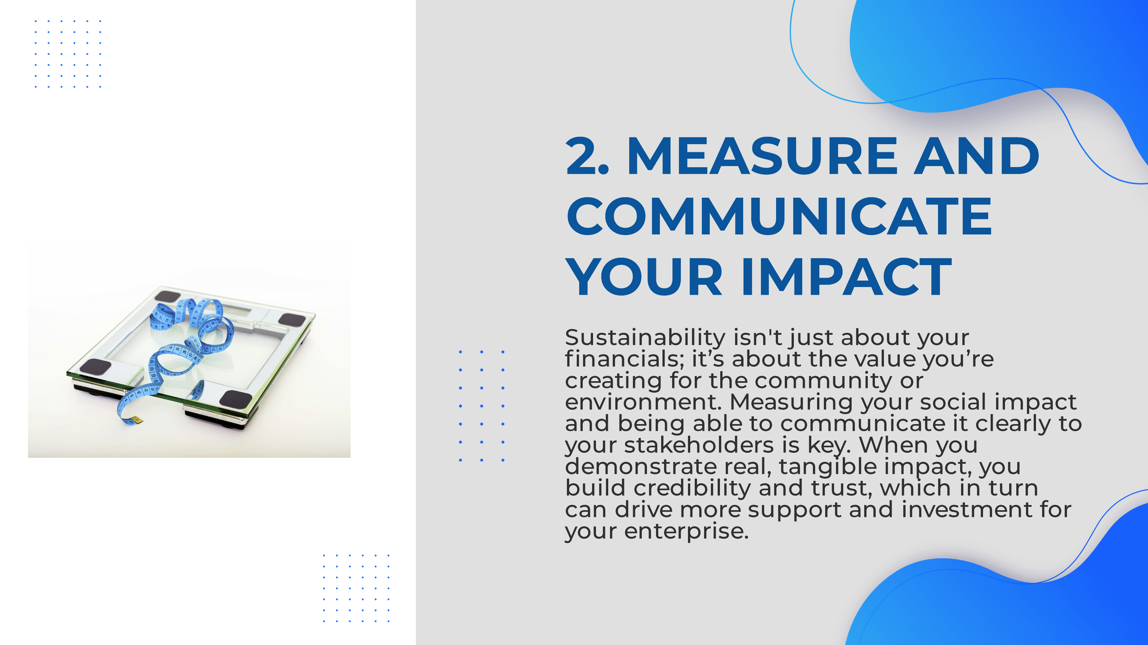
Notes:
2. Measure and Communicate Your Impact: Sustainability isn't just about your financials; it’s about the value you’re creating for the community or environment. Measuring your social impact and being able to communicate it clearly to your stakeholders is key. When you demonstrate real, tangible impact, you build credibility and trust, which in turn can drive more support and investment for your enterprise.

Slide 26
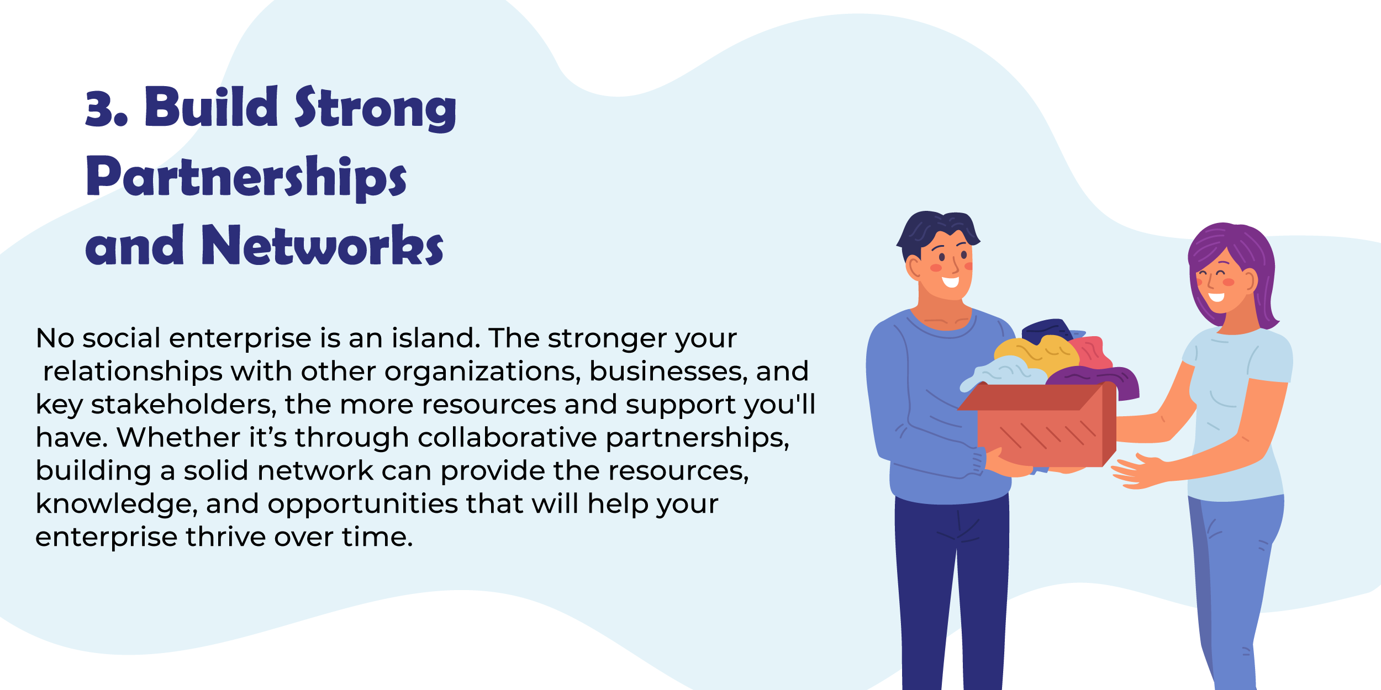
Notes:
3. Build Strong Partnerships and Networks: No social enterprise is an island. The stronger your relationships with other organizations, businesses, and key stakeholders, the more resources and support you'll have. Whether it’s through collaborative partnerships, building a solid network can provide the resources, knowledge, and opportunities that will help your enterprise thrive over time.

Slide 27
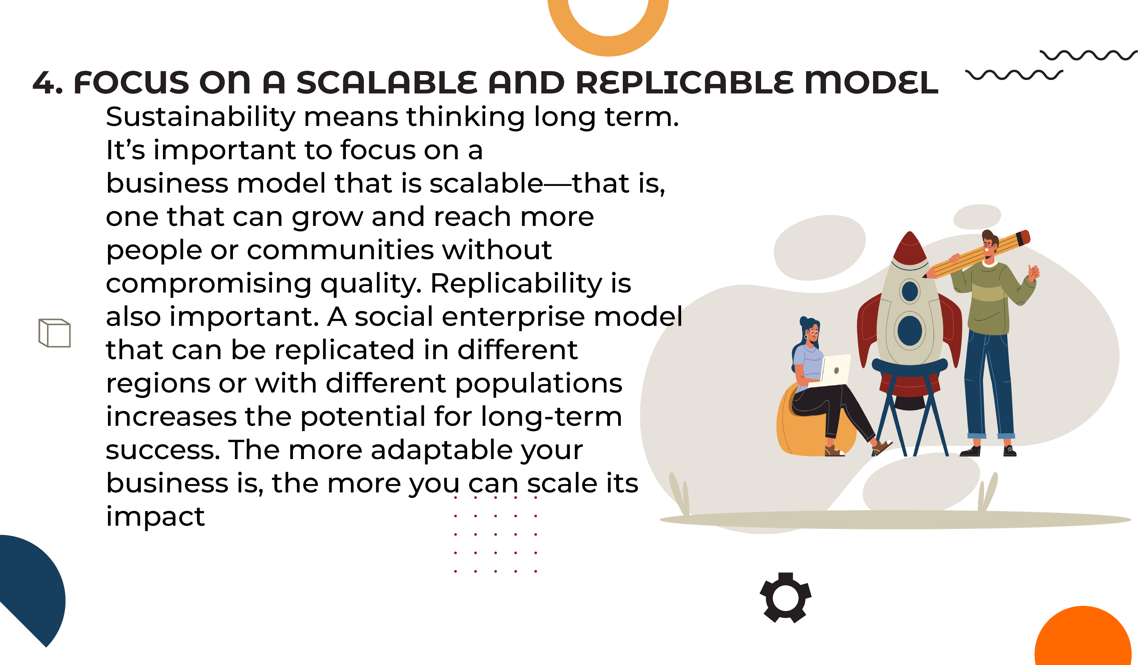
Notes:
4. Focus on a Scalable and Replicable Model: Sustainability means thinking long term. It’s important to focus on a business model that is scalable—that is, one that can grow and reach more people or communities without compromising quality. Replicability is also important. A social enterprise model that can be replicated in different regions or with different populations increases the potential for long-term success. The more adaptable your business is, the more you can scale its impact

Slide 28
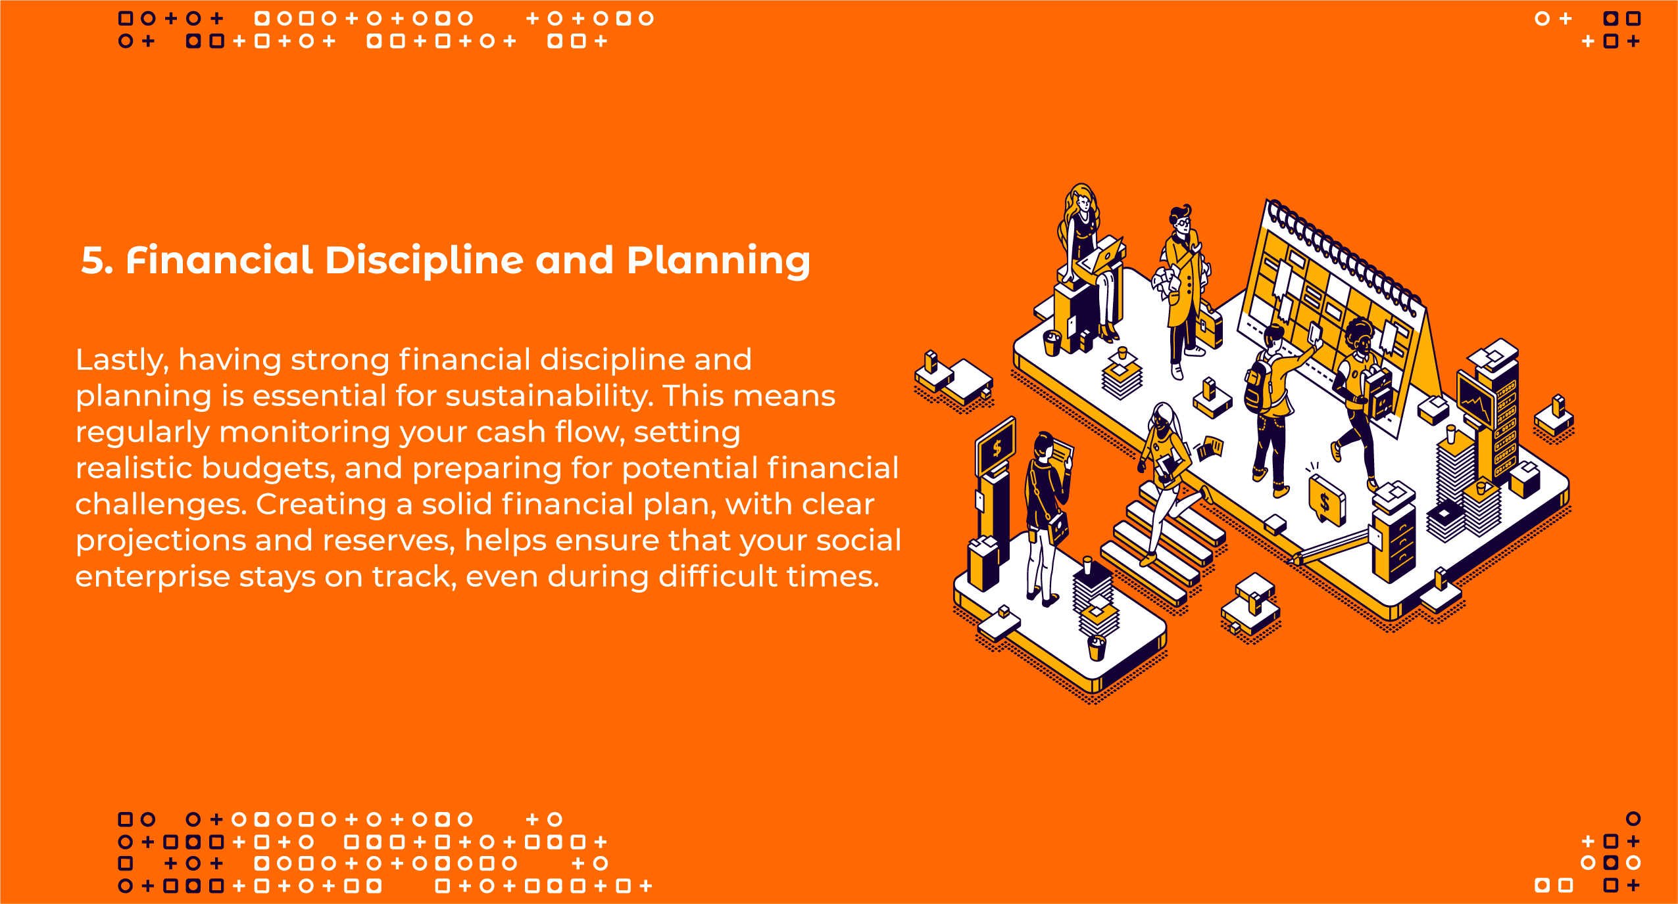
Notes:
5. Financial Discipline and Planning: Lastly, having strong financial discipline and planning is essential for sustainability. This means regularly monitoring your cash flow, setting realistic budgets, and preparing for potential financial challenges. Creating a solid financial plan, with clear projections and reserves, helps ensure that your social enterprise stays on track, even during difficult times.

Slide 29

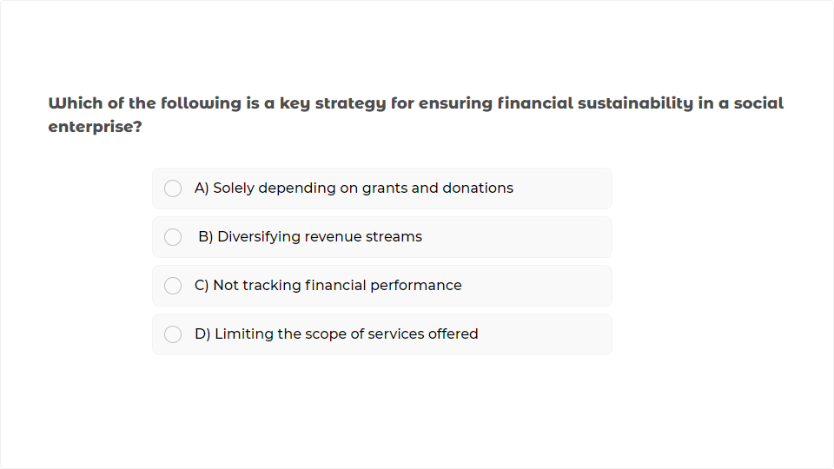
Quiz
Click the Quiz button to edit this object

Slide 30
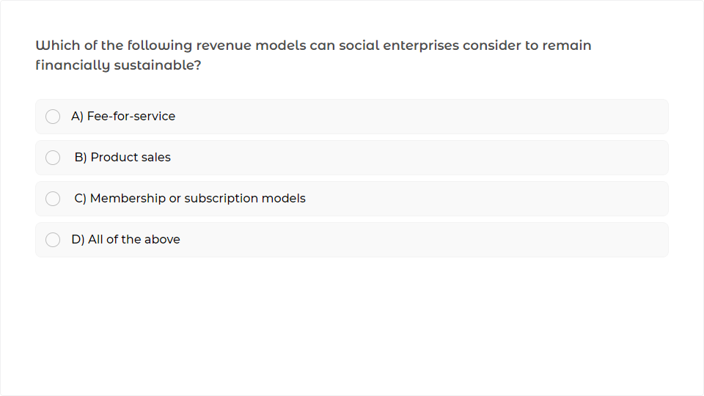
Quiz
Click the Quiz button to edit this object

Slide 31
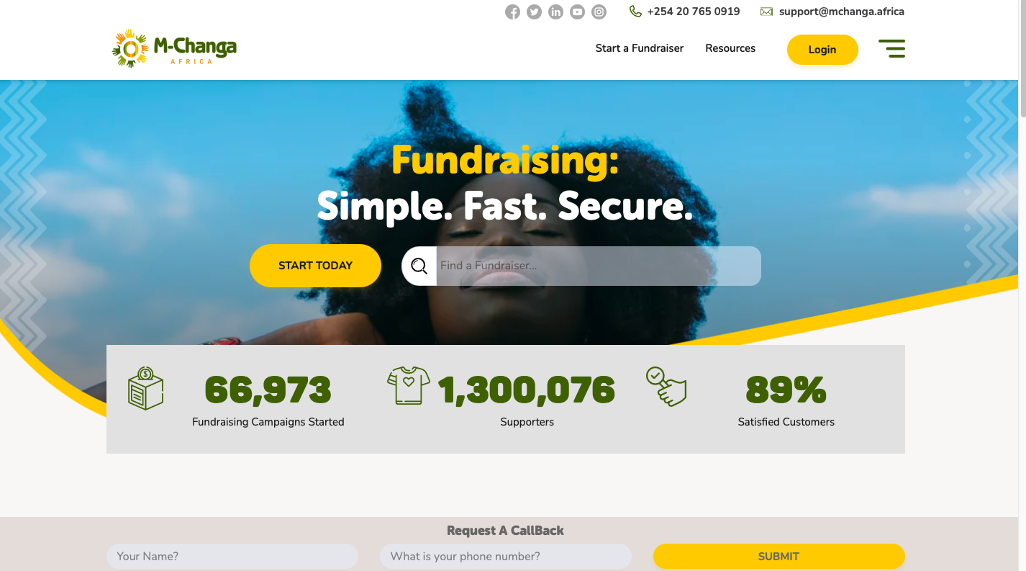

Crowdfunding
Mobilizing resources through different Online platforms- Social Media, Website etc
Some Platforms
M- Changa www.mchanga.co.ke
GoFundMe www.gofundme.org
Global Giving www.globalgiving.org
Notes:
Let’s talk about crowdfunding. crowdfunding is the practice of raising small amounts of money from a large number of people, typically through an online platform. Instead of relying on a few big investors or traditional bank loans, you’re reaching out to the crowd—people who share your passion and believe in your idea. It’s a community-based way of funding that’s both inclusive and empowering.

Slide 32
Crowdfunding Campaign
Define Your Campaign Goal
Choose the Right Crowdfunding Platform
Create a Compelling Story
Plan Your Marketing and Promotion
Offer Rewards or Incentives
Set a Realistic Funding Target
. Engage with Your Backers
Follow Through and Deliver
Notes:
Let’s talk about how to set up a successful crowdfunding campaign. Crowdfunding is more than just a way to raise money—it’s a way to build a community around your cause.
Here’s a step-by-step process:

Slide 33

1. Define Your Campaign Goal
Notes:
1. Define Your Campaign Goal Before anything, you need to be clear about what you’re raising funds for. Whether it’s for a social impact project, or a community initiative, your goal should be specific, realistic, and well-articulated. Make sure it’s easy to understand and shows what the funds will be used for.

Slide 34

2. Choose the Right Crowdfunding Platform
Notes:
2. Choose the Right Crowdfunding Platform There are many crowdfunding platforms out there, each with its own strengths. Some of the most popular ones include, GoFundMe, and Indiegogo. Choose one that aligns with your project’s mission and audience.

Slide 35

3. Create a compelling story
Notes:
3. Create a Compelling Story This is your chance to connect emotionally with your audience. People are more likely to fund when they feel personally connected to your cause. Share your story—why are you passionate about this project? What problem are you solving, and why does it matter? Include any personal anecdotes, photos, or videos that can help bring your cause to life. A good video, for instance, can explain your vision and make a strong impact.

Slide 36

4. Set a realistic Funding Target
Notes:
4. Set a Realistic Funding Target Be strategic about how much money you need to raise. Make sure your target is achievable but also enough to cover your costs and help you reach your goals. Platforms like Kickstarter use an “all-or-nothing” model, where if you don’t reach your funding goal, you don’t get any of the contributions. So, set a goal that’s realistic but also challenges you to push for your full potential.

Slide 37

5. Offer Rewards or Incentives
Notes:
5. Offer Rewards or Incentives One of the best ways to get people to back your project is to offer rewards. Think about what you can give in return for different levels of contribution. These could be exclusive products, early access to your service, thank-you notes, or recognition on your website. Make sure your rewards are attractive and reflect the value of the donation.

Slide 38

6. Plan Your Marketing and Promotion
Notes:
6. Plan Your Marketing and Promotion You can’t just launch a campaign and expect the money to roll in. You need to actively promote it to get visibility. Use social media, email newsletters, and your website to spread the word. Reach out to your network—friends, family, supporters—and ask them to help share your campaign. You can even consider creating a launch event or campaign countdown to build excitement.

Slide 39

7. Engage With Your Backers
Notes:
7. Engage with Your Backers Throughout your campaign, make sure to engage with your backers. Keep them updated with progress and milestones. Respond to questions or comments and show your gratitude. Transparency is key to maintaining trust and excitement throughout the process. The more you involve your supporters, the more invested they’ll feel in your success.

Slide 40

8. Follow through and Deliver
Notes:
8. Follow Through and Deliver Once your campaign is over and the funds are raised, it’s important to follow through on your promises. If you offered rewards, make sure they are delivered on time. Keep your backers updated on how their contributions are helping bring your project to life. This helps you build trust and potentially cultivate long-term supporters for future campaigns.

Slide 41
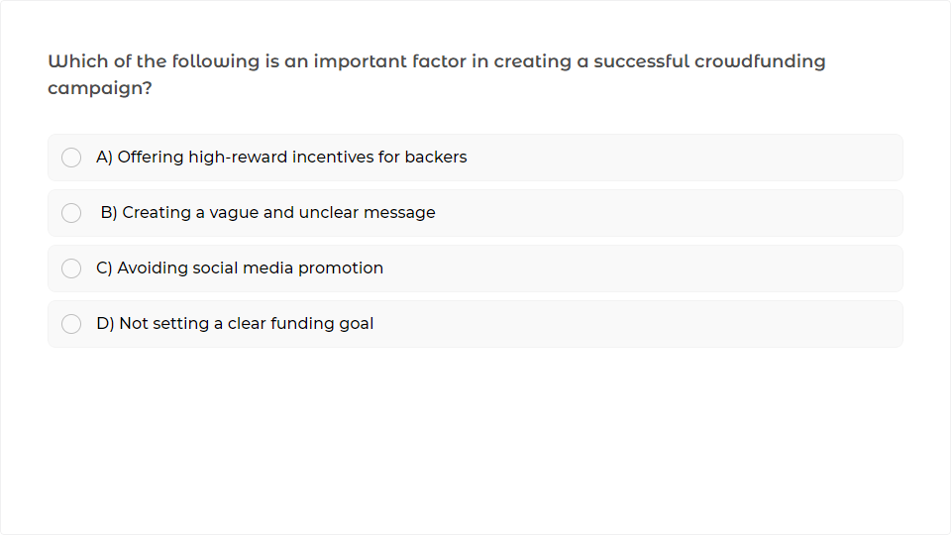
Quiz
Click the Quiz button to edit this object

Slide 42
Consortium Formation
A consortium is a group of organizations coming together to achieve a common goal that they might not be able to reach on their own.
Why Consortium Formation
Shared Resources
Increased Credibility and Influence
The Power of Diverse Expertise
Notes:
Let's talk about consortium formation—a powerful strategy for tackling big challenges, pooling resources, and making a greater impact.
A consortium is a group of organizations coming together to achieve a common goal that they might not be able to reach on their own. Think of it as teamwork, but on a larger scale. Each member brings something unique to the table—whether it’s expertise, resources, or networks—and by joining forces, the group becomes much stronger.So, why form a consortium? Well, there are several key benefits. First, shared resources. Instead of each organization struggling to gather all the resources it needs, a consortium allows for a more efficient use of time, money, and effort. You can leverage the strengths of each partner, making it easier to tackle complex projects or large-scale initiatives.

Slide 43
Consortium Formation
A consortium is a group of organizations coming together to achieve a common goal that they might not be able to reach on their own.
Why Consortium Formation
Shared Resources
Increased Credibility and Influence
The Power of Diverse Expertise
Notes:
Second, there’s the power of diverse expertise. Each member of a consortium often specializes in a different area—whether it's research, community outreach, technology, or finance. This diversity enables the consortium to approach problems from multiple angles, leading to better solutions and greater innovation.
And let's not forget about increased credibility and influence. When multiple respected organizations come together, the consortium gains more visibility and legitimacy. It can attract more funding, partnerships, and opportunities that individual organizations might struggle to get on their own.

Slide 44
Consortium Formation- Keep in Mind
While forming a consortium it's important to keep in the mind:
Keep in Mind
Set Clear Objectives
Governance Structures
Define Roles and Responsibilities
Communication
Conflict Resolution Mechanisms
Notes:
Now, when you're forming a consortium, there are a few important things to keep in mind. Clear objectives are paramount. Everyone involved needs to be on the same page about what the consortium is aiming to achieve. Whether it’s delivering a large-scale project, driving policy change, or addressing a community need, clarity will guide your actions.Next, roles and responsibilities. Make sure each partner knows exactly what they’re responsible for. It’s important to avoid overlap and confusion, ensuring that each member can contribute in the best way possible.And don’t forget about governance—how decisions will be made. Having a transparent decision-making process is vital for keeping things on track and resolving any conflicts that might arise.

Slide 45
Consortium Formation- Keep in Mind
While forming a consortium it's important to keep in the mind:
Keep in Mind
Set Clear Objectives
Governance Structures
Define Roles and Responsibilities
Communication
Conflict Resolution Mechanisms
Notes:
Remember, communication is key. You’ll need regular check-ins, updates, and clear communication between partners to make sure everyone stays aligned, and any issues are dealt with quickly.Finally, conflicts in a consortium are inevitable, but by establishing clear communication, defining roles, creating formal resolution protocols, and focusing on shared goals, these conflicts can be managed and even used as opportunities for growth and improvement.

Slide 46
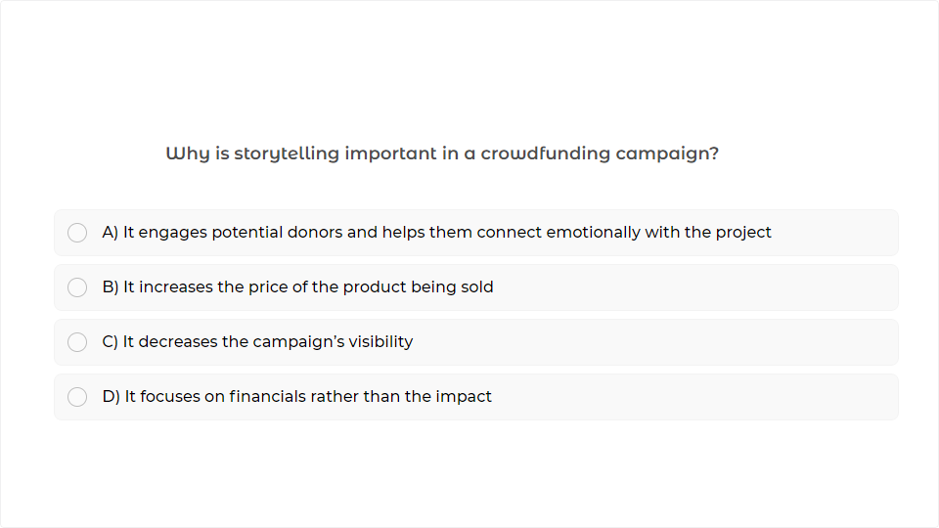
Quiz
Click the Quiz button to edit this object
Notes:
Why is storytelling important in a crowdfunding campaign?

Slide 47
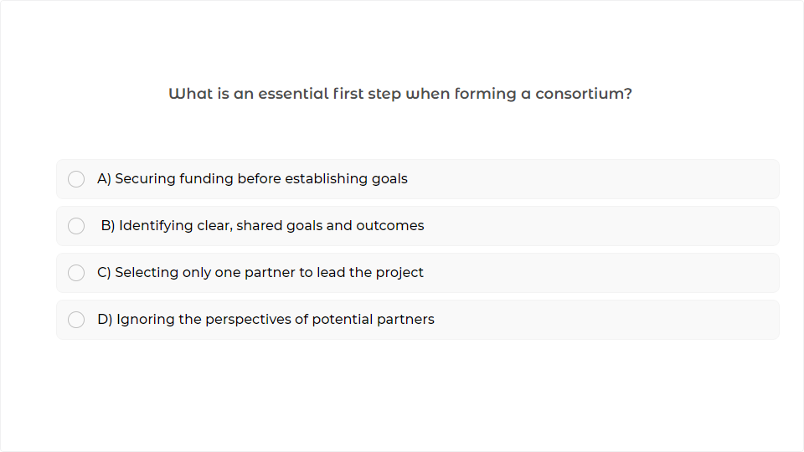
Quiz
Click the Quiz button to edit this object
Notes:
What is an essential first step when forming a consortium?

Slide 48
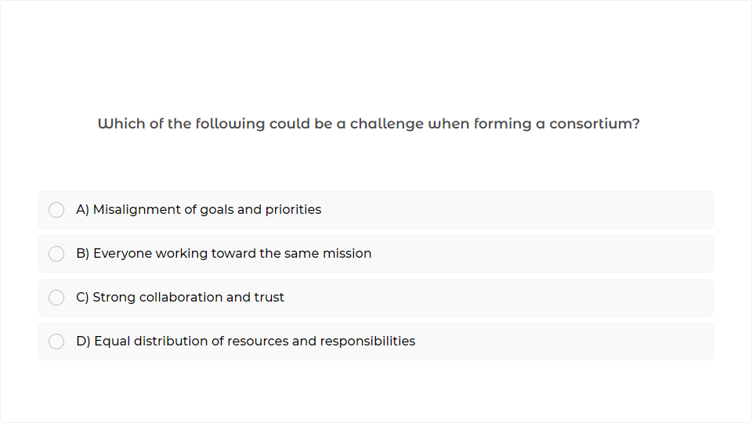
Quiz
Click the Quiz button to edit this object
Notes:
Which of the following could be a challenge when forming a consortium?

Slide 49

Notes:
Congratulations on finishing this section.

